Slide 1
Security Management
CSC 504
LECTURE SERIES

Slide 2
The Security Problem
Program Threats
System and Network Threats
Cryptography as a Security Tool
User Authentication
Implementing Security Defenses
Firewalling to Protect Systems and Networks
Computer-Security Classifications

Slide 3
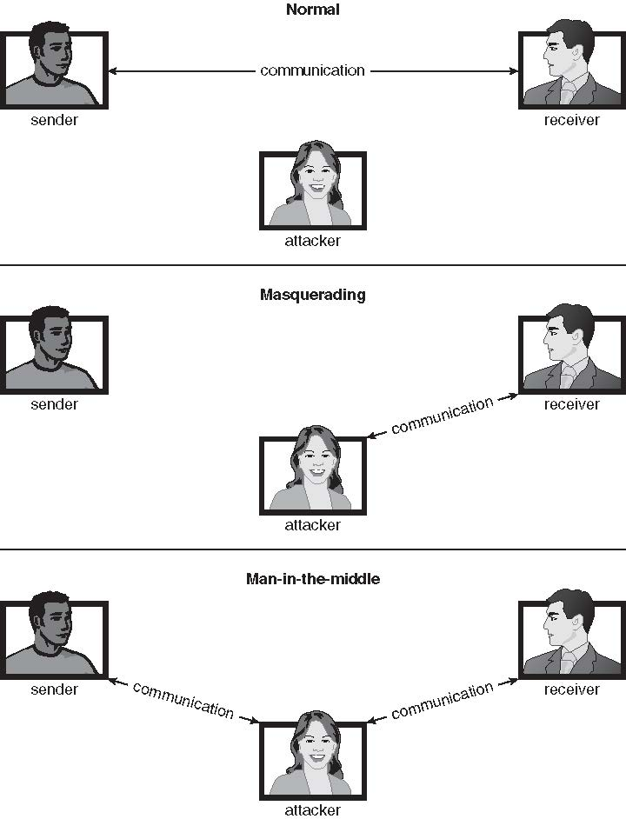
Middle man operations

Slide 4
Nature of Problems
System secure if resources used and accessed as intended under all circumstances
Unachievable
Intruders (crackers) attempt to breach security
Threat is potential security violation
Attack is attempt to breach security
Attack can be accidental or malicious
Easier to protect against accidental than malicious misuse

Slide 5
…
Breach of confidentiality
Unauthorized reading of data
Breach of integrity
Unauthorized modification of data
Breach of availability
Unauthorized destruction of data
Theft of service
Unauthorized use of resources
Denial of service (DOS)
Prevention of legitimate use

Slide 6
…
Masquerading (breach authentication)
Pretending to be an authorized user to escalate privileges
Replay attack
As is or with message modification
Man-in-the-middle attack
Intruder sits in data flow, masquerading as sender to receiver and vice versa
Session hijacking
Intercept an already-established session to bypass authentication
Script kiddies can run pre-written exploit code to attack a given system
Attack code can get a shell with the processes’ owner’s permissions
Or open a network port, delete files, download a program, etc
Depending on bug, attack can be executed across a network using allowed connections, bypassing firewalls

Slide 7
…
Many variations, many names
Trojan Horse
Code segment that misuses its environment
Exploits mechanisms for allowing programs written by users to be executed by other users
Spyware, pop-up browser windows, covert channels
Up to 80% of spam delivered by spyware-infected systems
Trap Door
Specific user identifier or password that circumvents normal security procedures
Could be included in a compiler
How to detect them?

Slide 8
Logic Bomb
Program that initiates a security incident under certain circumstances
Stack and Buffer Overflow
Exploits a bug in a program (overflow either the stack or memory buffers)
Failure to check bounds on inputs, arguments
Write past arguments on the stack into the return address on stack
When routine returns from call, returns to hacked address
Pointed to code loaded onto stack that executes malicious code
Unauthorized user or privilege escalation

Slide 9
Viruses
Code fragment embedded in legitimate program
Self-replicating, designed to infect other computers
Very specific to CPU architecture, operating system, applications
Usually borne via email or as a macro
Visual Basic Macro to reformat hard drive
Sub AutoOpen()
Dim oFS
Set oFS = CreateObject(’’Scripting.FileSystemObject’’)
vs = Shell(’’c:command.com /k format c:’’,vbHide)
End Sub

Slide 10
Viruses
Code fragment embedded in legitimate program
Self-replicating, designed to infect other computers
Very specific to CPU architecture, operating system, applications
Usually borne via email or as a macro
Visual Basic Macro to reformat hard drive
Sub AutoOpen()
Dim oFS
Set oFS = CreateObject(’’Scripting.FileSystemObject’’)
vs = Shell(’’c:command.com /k format c:’’,vbHide)
End Sub

Slide 11
Attacks still common, still occurring
Attacks moved over time from science experiments to tools of organized crime
Targeting specific companies
Creating botnets to use as tool for spam and DDOS delivery
Keystroke logger to grab passwords, credit card numbers

Slide 12
Security measures
Impossible to have absolute security, but make cost to perpetrator sufficiently high to deter most intruders
Security must occur at four levels to be effective:
Physical
Data centers, servers, connected terminals
Human
Avoid social engineering, phishing, dumpster diving
Operating System
Protection mechanisms, debugging
Network
Intercepted communications, interruption, DOS
Security is as weak as the weakest link in the chain
But can too much security be a problem?

Slide 13
Some systems “open” rather than secure by default
Reduce attack surface
But harder to use, more knowledge needed to administer
Network threats harder to detect, prevent
Protection systems weaker
More difficult to have a shared secret on which to base access
No physical limits once system attached to internet
Or on network with system attached to internet
Even determining location of connecting system difficult
IP address is only knowledge

Slide 14
Port scanning
Automated attempt to connect to a range of ports on one or a range of IP addresses
Detection of answering service protocol
Detection of OS and version running on system
nmap scans all ports in a given IP range for a response
nessus has a database of protocols and bugs (and exploits) to apply against a system
Frequently launched from zombie systems
To decrease trace-ability

Slide 15
Denial of Service
Overload the targeted computer preventing it from doing any useful work
Distributed denial-of-service (DDOS) come from multiple sites at once
Consider the start of the IP-connection handshake (SYN)
How many started-connections can the OS handle?
Consider traffic to a web site
How can you tell the difference between being a target and being really popular?
Accidental – CS students writing bad fork() code
Purposeful – extortion, punishment

Slide 16
Cryptography
Broadest security tool available
Internal to a given computer, source and destination of messages can be known and protected
OS creates, manages, protects process IDs, communication ports
Source and destination of messages on network cannot be trusted without cryptography
Based on secrets (keys)
Enables
Confirmation of source
Trust relationship between sender and receiver
Local network – IP address?
Consider unauthorized host added
WAN / Internet – how to establish authenticity
Not via IP address

Slide 17
Encryption
Constrains the set of possible receivers of a message
Encryption algorithm consists of
Set K of keys
Set M of Messages
Set C of ciphertexts (encrypted messages)
A function E : K → (M→C). That is, for each k ∈ K, E_{k} is a function for generating ciphertexts from messages
Both E and E_{k} for any k should be efficiently computable functions
A function D : K → (C → M). That is, for each k ∈ K, D_{k} is a function for generating messages from ciphertexts
Both D and D_{k} for any k should be efficiently computable functions
An encryption algorithm must provide this essential property: Given a ciphertext c ∈ C, a computer can compute m such that E_{k}(m) = c only if it possesses k
Thus, a computer holding k can decrypt ciphertexts to the plaintexts used to produce them, but a computer not holding k cannot decrypt ciphertexts
Since ciphertexts are generally exposed (for example, sent on the network), it is important that it be infeasible to derive k from the ciphertexts

Slide 18
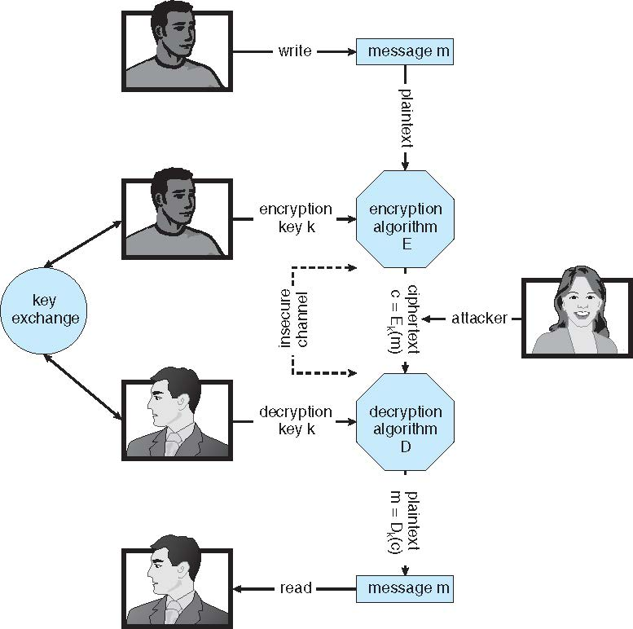
Symmetric encryption- key exchange important

Slide 19
Asymmetric Encryption
Public-key encryption based on each user having two keys:
public key – published key used to encrypt data
private key – key known only to individual user used to decrypt data
Must be an encryption scheme that can be made public without making it easy to figure out the decryption scheme
Most common is RSA block cipher
Efficient algorithm for testing whether or not a number is prime
No efficient algorithm is know for finding the prime factors of a number
Formally, it is computationally infeasible to derive k_{d,N} from k_{e,N}, and so k_{e} need not be kept secret and can be widely disseminated
k_{e} is the public key
k_{d} is the private key
N is the product of two large, randomly chosen prime numbers p and q (for example, p and q are 512 bits each)
Encryption algorithm is E_{ke,N}(m) = m^{ke} mod N, where k_{e} satisfies k_{e}k_{d} mod (p−1)(q −1) = 1
The decryption algorithm is then D_{kd,N}(c) = c^{kd} mod N

Slide 20
Asymmetric example
For example. make p = 7and q = 13
We then calculate N = 7∗13 = 91 and (p−1)(q−1) = 72
We next select k_{e} relatively prime to 72 and< 72, yielding 5
Finally, we calculate k_{d} such that k_{e}k_{d} mod 72 = 1, yielding 29
We how have our keys
Public key, k_{e,N} = 5, 91
Private key, k_{d,N} = 29, 91
Encrypting the message 69 with the public key results in the cyphertext 62
Cyphertext can be decoded with the private key
Public key can be distributed in cleartext to anyone who wants to communicate with holder of public key

